Slide 1
Intelligence and Personality

Slide 2
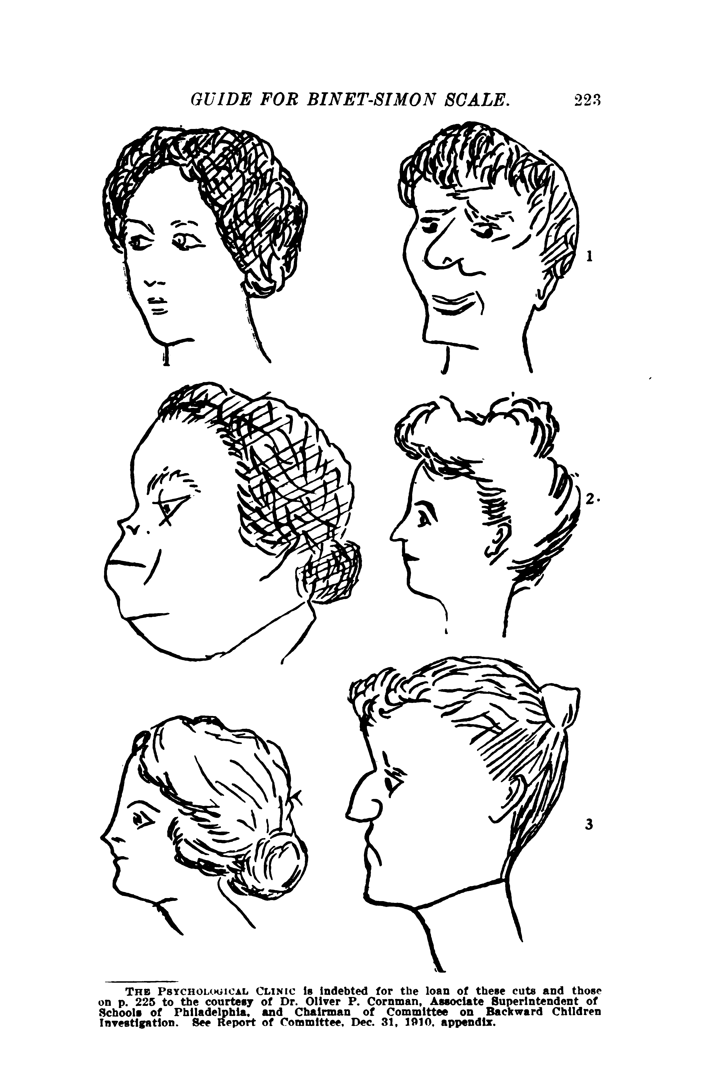
When was Intelligence first looked at??
The notion of testing humans to rate their intelligence was first proposed in 1905 by Alfred Binet and his student Theodore Simon.
They developed a test (Simon-Binet test) that they believed would help educators distinguish “more intelligent” children from children who were “less intelligent.”
In 1916 Lewis Terman (psychologist working at Stanford University) designed a system of categorizing intelligence in adults as well as children. This test was named the Stanford-Binet test. This test took anyone’s final test score and determined his/her intelligence based on that person’s age. This measure of intelligence became known as the intelligence Quotient or IQ.

Slide 3
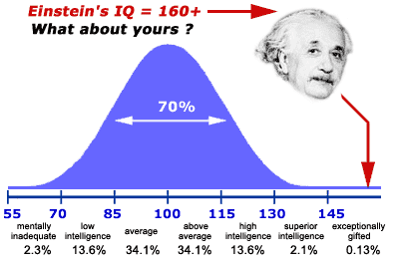

Slide 4
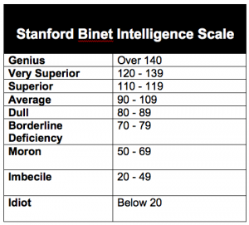
Issues With IQ TESTS?
Most psychologists now agree that IQ scores only measure one area of intelligence: a person’s ability to take a test.
What influence does society have on IQ??
-upbringing (culture)
-school
-Positive or negative feedback → Self-fulfilling prophecy
-Cultural Bias

Slide 5
https://www.youtube.com/watch?v=pdqreAr6JFc Pull out a piece of paper

Slide 6
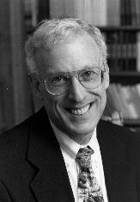
Sternberg’s theory of successful Intelligence
Robert Sternberg proposed his Triarchic Theory of Intelligence in the 1980’s
-Sternberg’s definition of human intelligence is a mental activity directed toward purposive adaptation to, selection and shaping of, real-world environments relevant to one’s life, which means that intelligence is how well an individual deals with environmental changes throughout their lifespan. Sternberg’s theory comprises three parts:
-componential (analytical)
-experiential (creative)
-practical (contextual)
https://www.youtube.com/watch?v=L7C7qIRYiv0

Slide 7
Sternberg’s theory
Sternberg believes how much intelligence a person has is not important; what is important is how the person uses the intelligence.

Slide 8
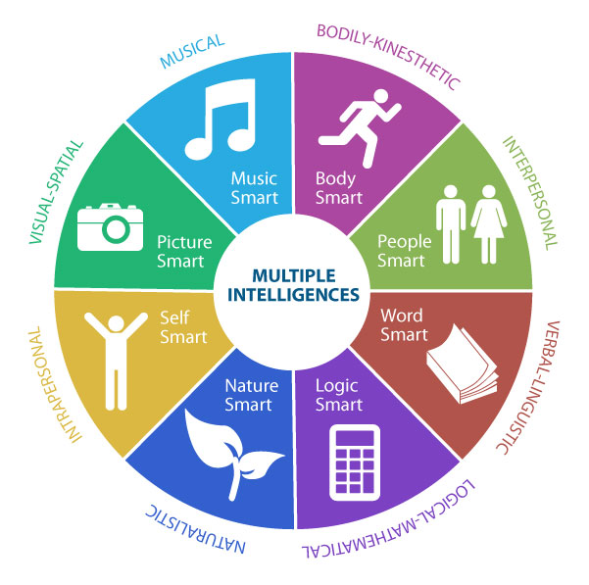
Gardner’s Theory of Multiple Intelligences
1983 Howard Gardner proposed that intelligence was diversified and multifaceted.
-You could be intelligent in one area (such as math) and another person may be intelligent in another totally-unrelated area (such as music), but both exhibit equally important intelligences.
Gardner was among the first psychologists to broaden the definition of intelligence beyond just mathematical, logical and verbal reasoning.

Slide 9
Existential: Gardner did not want to commit to a spiritual intelligence, but suggested that an "existential" intelligence may be a useful construct,

Slide 10
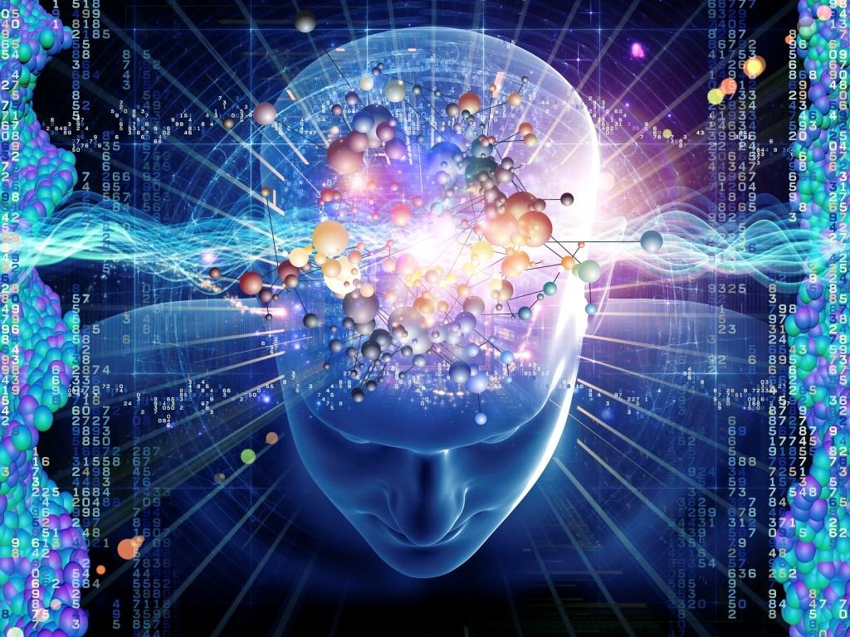
Hunt’s Theory on Problem-Solving Intelligence
1980’s Earl Hunt was more interested in studying the individual differences in problem solving.
Believed that intelligence should be measured by analyzing an individual’s unique ability to solve problems.
Interested in how the individual represented the problem in his/her mind and the various strategies the person could develop to solve the problem.
Interested in finding the best use for each person’s unique style of problem solving

Slide 11
Vygotsky’s Zone of Proximal Intelligence
Lev Vygotsky had a very forward thinking of intelligence.
-Believed that a child’s intelligence should be measured by his/her proximal development.
Zone of Proximal development: is the difference between what a child can do on his/her own and what the child can do with teaching and instruction. Therefore, Vygotsky believed that an intelligent child will be able to learn from others.
The concept of the zone of proximal development was originally developed by Vygotsky to argue against the use of academic, knowledge-based tests as a means to gauge students' intelligence.

Slide 12
Cattell’s Two Factor Theory of Intelligence
Raymond Cattell believed that people have two types of intelligence- Fluid intelligence and crystallized intelligence
Fluid Intelligence: The type of intelligence a person is born with. Intelligence that is not learned in schools. “STREET SMARTS”
Crystallized Intelligence: The type of knowledge learned in school.
Catell believed that the kind of intelligence measured by standard IQ tests was important, but he also believed a person’s “street smarts” was equally important.

Slide 13
Benefits and Drawbacks of Group and Individual Testing
Group Tests:
PROS: Less expensive, not as time consuming, more data in a short period of time, easy to administer
CONS: Inaccurate information recorded, in a group you can’t test different aspects of intelligence such as Gardner’s interpersonal intelligence theory.
Individual Tests:
PROS: Not influenced by outside behavior in the current situation, test different types of intelligence,
CONS: Time consuming, expensive

Slide 14
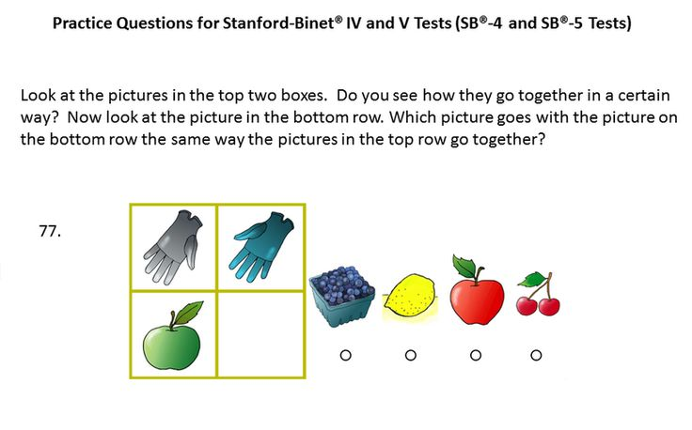
Different Tests
The revised Standford-Binet Test:
Traditional IQ test that gives an IQ score.
Measured individually
Measures intelligence in four separate areas (verbal reasoning, quantitative reasoning, abstract/visual reasoning, and short-term memory)
-Usually used to identify individuals who may be considered “gifted” or who have serious learning problems

Slide 16
Weschler Intelligence Scale for children (wisc-iii)
Very much like the Standford-Binet test but differs because it also measures vocabulary, block design ability, number span, and the ability of a child to understand.
Administered individually, and children must answer both verbally and perform certain tasks.
Also used to identify “gifted” children as well as children who may have serious learning problems.
This test has been re-vised two times to eliminate cultural bias.
There is also an adult version of the test that is available.

Slide 17
WISC- III
Verbal Task:
-Describe how objects and/or concepts are similar to each other
-Define concepts of increasing difficulty
-Children are asked why some things are done in certain ways to check their understanding and comprehension’
-Children are asked general questions about things most children their age would know
Performance Scale:
-Children assemble puzzles and duplicate designs of play-blocks
-Pencil mazes are presented, and the subject is asked to find the way out
-After being shown pictures, children are asked to tell what the missing picture is
-Subjects are asked to put in the proper order a series of photographs that tell a story

Slide 18
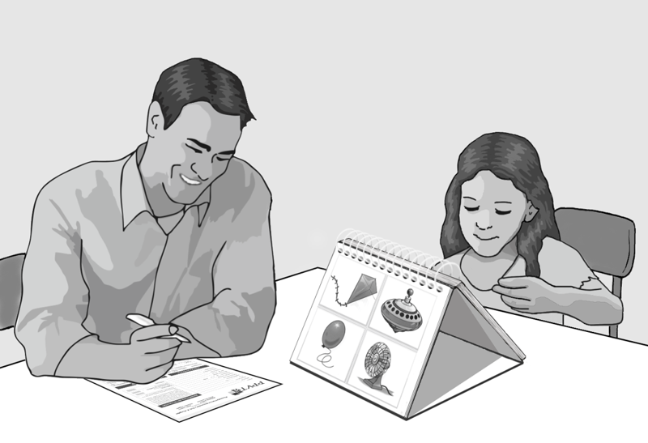
Peabody Picture Vocabulary Test-Revised
Is an untimed, individual test that usually takes about 15 minutes to administer.
The examiner says a word and the person being tested must point to one of the 4 pictures that represent the word.
The words are arranged from least to most difficult and the test concludes when the person answers incorrectly 6 times in a row.
This test measures only vocabulary and is used to identify adults and children with severe communication difficulties or with poor reading skills

Slide 19
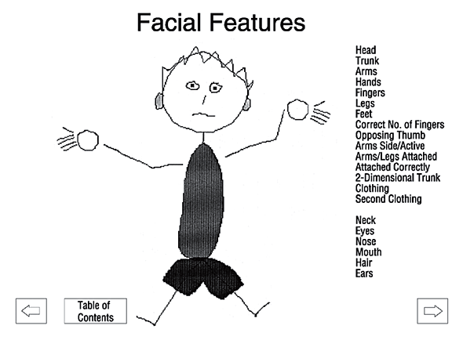
Draw-A-Person Test
This is a group test in which a child is asked to draw a person as well as he/she can in a certain time frame. The drawing is then scored according to specific criteria.
This test is supposed to assess the mental development of the child as well as provide an indicator of the child’s emotional well-being.

Slide 21
Cognitive Abilities Test
-Also referred to as (CogAT) is a group test that can be given to students in grades three to thirteen.
-It gives three different scores for verbal reasoning, non-verbal reasoning, and quantitative reasoning.
-Used to assess how well a child is doing in school compared to other children of the same age.
-These tests are very similar to the standardized tests given in Canada in grades six, nine, and for final grades

Slide 22
The Biased nature of iq and standardized tests
Culture Bias (Remember Raymond Cattell recognized the way tests discriminated against the less privileged and people from other cultures)
Tests a person’s ability to take a test or their preparation.
Other factors can influence a test score (life events, tired, stress, hungry, etc)
Labelling → Self-fulfilling prophecy

Slide 23
IQ CORRELATIONS
IQ and Birth Order:
Over a hundred years ago Francis Galton recognized a trend that many noted intellectuals were the first-born children in their families. These children not only had a higher IQ, but also had a higher need to achieve, and were more likely to attend college.
IQ Stability across different ages:
At one time psychologists believed a person’s IQ remained constant throughout their life.
In 1987, Flynn examined data in 14 countires, spanning over 50 years and discovered that IQ scores increased as people got older. This correlation was later termed the Flynn Effect.

Slide 24
IQ CORRELATIONS
IQ and family income:
Higher IQ scores with an increase in family income
WHY???
-Provide the necessary resources such as textbooks, tutors, learning toys for children
IQ and Relatives’ IQ’s:
Psychologists have found that if a child’s parents have high Iqs than the child will most likely have high IQs.
Children will most likely benefit from their parents knowledge, have the help provided when needed, and children will most likely be expected to do as their parents have done (attend university for instance)

Slide 25
IQ CORRELATIONS
What about the brain size or structure??
https://www.youtube.com/watch?v=GxPWAw9nemU

Slide 26
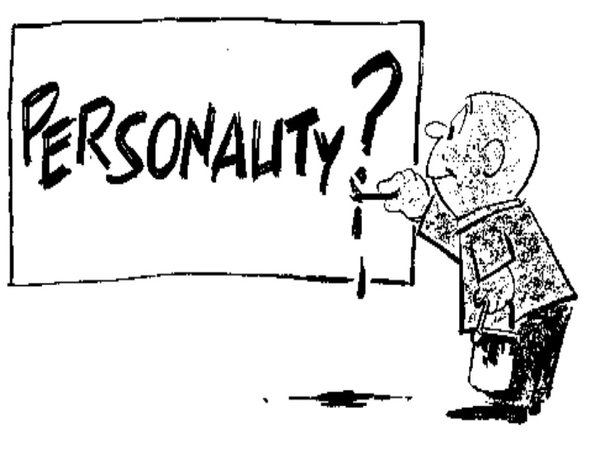
What is Personality???
Is it the way we act?
Is it who makes who we are?
Can it be defined by the people we hang out with?
Are we born with our personality?
Can we change our personality over time?
Personality: the combination of characteristics or qualities that form an individual's distinctive character.
https://www.youtube.com/watch?v=sUrV6oZ3zsk

Slide 27
Personality
1) Personality is what people must develop to get along in the world.
2) Others believe that a personality is a mathematical combination of various factors.
3) While others believe that a personality is the self that someone chooses to show others.
Personality, in the field of organizational behavior, is the person’s feelings, thinking, behaviors and responses to different situations and people.
-However, there is not one universally-accepted personality theory because it is impossible to prove that theory in a scientific manner.

Slide 28
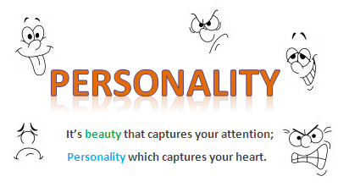
Possible Determinants of Personality????

Slide 29
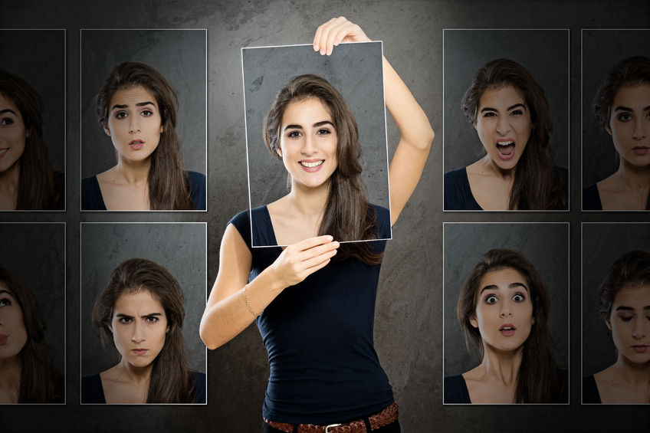
Determinants of personality
Genetics
Environment
Learning
Traits
Existential-humanistic considerations
Unconscious mechanisms
Cognitive Factors
Sociocultural factors
Personality as a composite of factors

Slide 30
Lets look at some personailities
https://www.youtube.com/watch?v=c8RxUN6pbhw
https://www.youtube.com/watch?v=VihlsPKMh4U
What about split personalities???
https://www.youtube.com/watch?v=n2atzoaA2NI
What causes split personalities??
https://www.youtube.com/watch?v=gfiB82OUXf0

Slide 31
Sigmund Freud
Intro to Sigmund Freud →https://prezi.com/palhmczcnchv/sigmund-freud/
https://prezi.com/baar68-zvlvq/sigmund-freud/
ID,EGO, & SUPEREGO
https://www.youtube.com/watch?v=NCXynjpFaKU

Slide 32
Sigmund Freud
Psychosexual Stages: Believed that all children had to go through similar experiences before they reached adulthood. He classified these experiences as occurring in 5 unique stages.
-Believed that any problem in adulthood could be traced back to something going wrong in one of these stages.
The Oral Stage
The Anal Stage
The Phallic Stage
The latency Stage
The Genital Stage

Slide 34
Criticisms of Freud’s work
Focuses too much on childhood
Lacks validity because they cannot be scientifically tested
Sexist against women

Slide 35
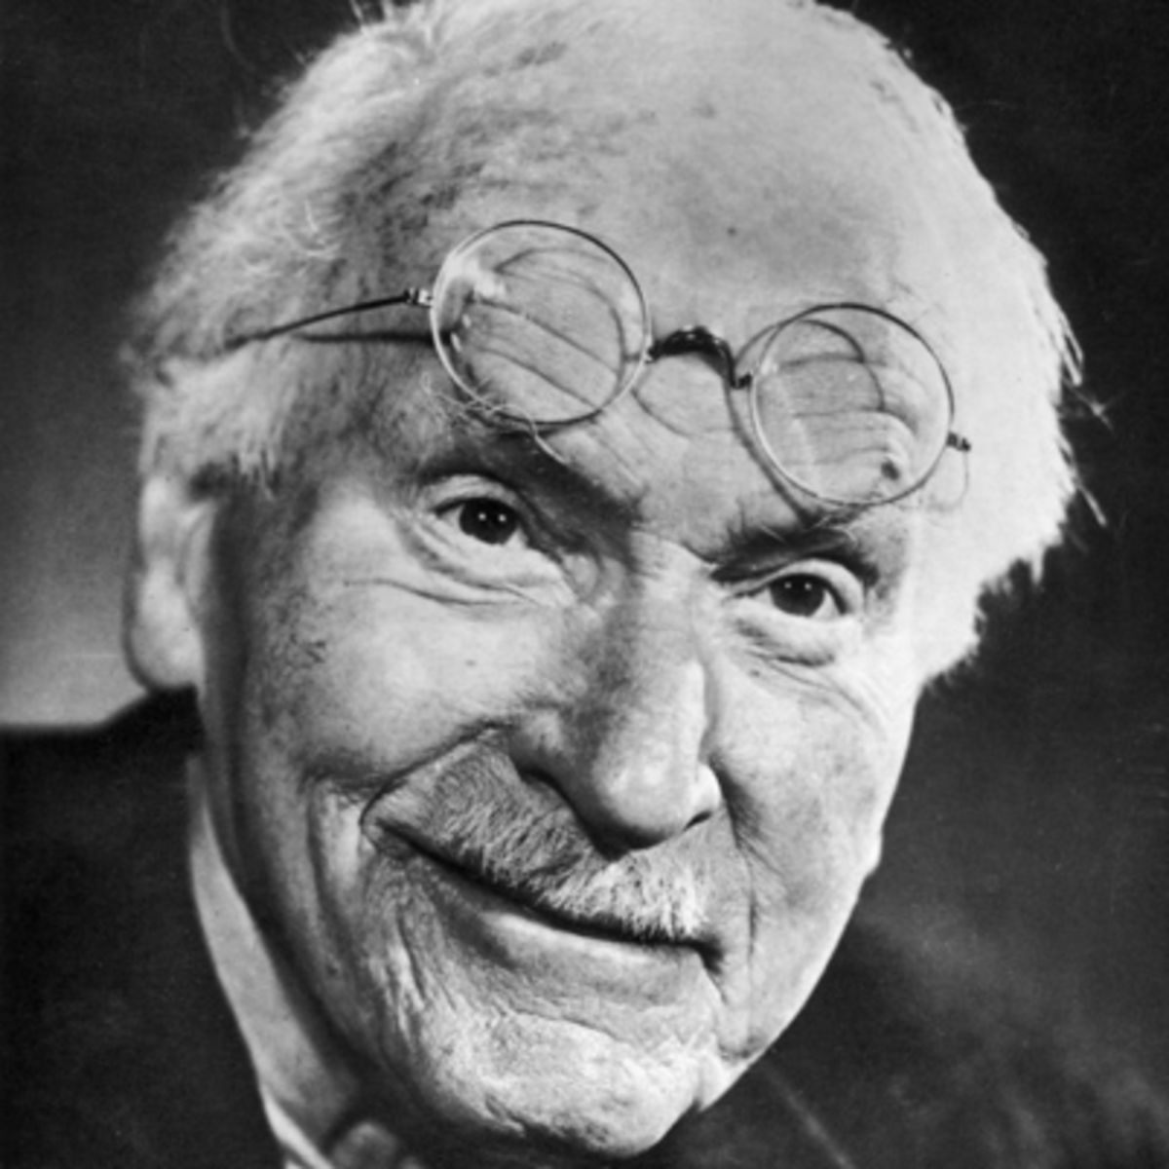
Carl Jung
Born in Switzerland in 1875, studied psychiatry.
Was a friend of Freud until Jung expressed some doubts about Freud’s theories.
The two men stopped communication and Jung entered into a dark period of his life full of depression and near madness.
Emerging from his 4 year absence he came back with a new individual theory on personality

Slide 36
Carl Jung
Jung, like Freud, believed that 3 components made up personality: the ego, the personal unconscious, and the collective unconscious.
Ego: represents everything about human beings having conscious thoughts.
Include thinking, remembering, and perceiving
Personal unconscious: Represents all that people were once conscious of in their past but have now forgotten
Includes disturbing thoughts that cannot be dealt with when they first occur
EX. These may be emotions felt when a parent unjustly punished, criticized, or abused a child
Collective unconscious: Represents the past thoughts and experiences of everyone’s previous ancestors, also called evolutionary experiences. These experiences are unconscious, but they may resurface during times of stress or danger.
Ex.Inborn fears of encountering strangers, large animals, or dangerous weather

Slide 37
Carl Jung
Popularized the terms Introverted and Extroverted
Extraversion is "the act, state, or habit of being predominantly concerned with obtaining gratification from what is outside the self". Extraverts tend to enjoy human interactions and to be enthusiastic, talkative, assertive, and gregarious. Extraverts are energized and thrive off of being around other people.
Introversion is "the state of or tendency toward being wholly or predominantly concerned with and interested in one's own mental life". Introverts are typically perceived as more reserved or reflective
https://www.youtube.com/watch?v=LxZ1fPr9FJg

Slide 38
Jungian Techniques
Word Association Test
Let’s Try it!!
Pull out a piece of paper and write down the first thought that comes to mind when I give you a word
https://www.youtube.com/watch?v=O4SH5uaGN3Y
-Was used to give the therapist a clue into thoughts held in a personal’s unconscious
Jung presented a client with certain stimulus words that were developed to (trigger potential memories) in the personal unconscious.
A client’s unusual response to the word (could include stammering, repeating or failing to respond) signaled to the therapist that he or she was very close to discovering a disturbing unconscious thought.
https://www.youtube.com/watch?v=hDplLi_N9B0

Slide 39
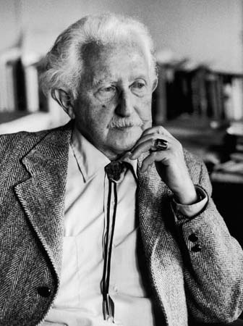
Erik Erikson
Born in Germany in 1902.
His ideas were greatly influenced by Freud, going along with Freud’s (1923) theory regarding the structure and topography of personality.
However, whereas Freud was an id psychologist, Erikson was an ego psychologist. He emphasized the role of culture and society and the conflicts that can take place within the ego itself, whereas Freud emphasized the conflict between the id and the superego.
Experiment Time!!!!
https://www.youtube.com/watch?v=kO1kgl0p-Hw

Slide 40
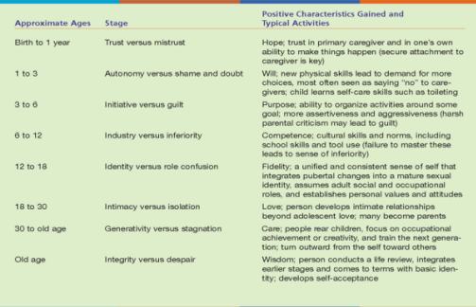

Slide 41
ERIKSON
The first five stages of Erikson’s eight stages of personality developments roughly correspond to Freud’s stages of psychosexual development.
However, Erikson focused less on sexuality and more on social demands put on individuals.
Criticisms:
Critics believed that Erikson’s theory was overly optimistic about how humans want to live.
Other critics believed that Erikson’s theory was simply his way of preaching to others how they should live.
His theory was unscientific because it resisted true scientific testing.

Slide 42
Raymond Cattell
Raymond Bernard Cattell was a British and American psychologist, known for his psychometric research into intrapersonal psychological structure and his exploration of many areas within empirical psychology. These multifaceted areas included: the basic dimensions of personality and temperament, the range of cognitive abilities, the dynamic dimensions of motivation and emotion, the clinical dimensions of abnormal personality, the applications of personality research to psychotherapy and learning theory, predictors of creativity and achievement, and many multivariate research methods including the refinement of factor analytic methods for exploring and measuring these domains.
TEST TIME!!

Slide 43
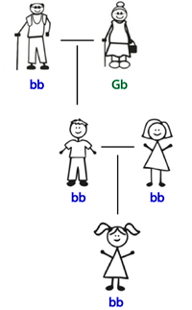
Cattell
Factor Analysis: Cattell’s way of determining scientifically the type of personality a person may have based on some of his/her traits. Cattell studied people’s traits and tried to identify correlations between the traits. By determining whether certain traits were related, Cattell hoped to be able to predict all the traits a person may possess based on only a few indicator traits.

Slide 44
B.F. Skinner
https://prezi.com/b0abooqethch/bf-skinner/
https://www.youtube.com/watch?v=I_ctJqjlrHA (example of operant conditioning)

Slide 45
Sociobiology Theory-Charles Darwin
Charles Darwin was one of the first scientists to propose a theory of evolution (survival of the fittest)
Sociobiologists- believed that people with adaptable personalities are able to pass their genes on to their off spring while people who are unable to adapt their personalities die out.

Slide 46
E.O. Wilson & D.P. BARASH’S EXTENSION
Wilson and Barash were two of the first psychologists to start applying sociobiology theories to human behavior. They produced sociobiological explanations for rape, suicide, and many other abnormal behaviors.
RAPE: They suggested that men whose genes were so inferior that they could never get a mat so this lead to rape.
SUICIDE: People committed suicide because again their genes they felt were inferior and not worth trying to pass on.

Slide 47
Survival of the Fittest →EUGENICS
What is Eugenics?
It is a social philosophy advocating the improvement of human genetic traits through the promotion of higher rates of sexual reproduction for people with desired traits (positive eugenics), or reduced rates of sexual reproduction and sterilization of people with less-desired or undesired traits
https://www.youtube.com/watch?v=BGq-MbmL5c0

Slide 48
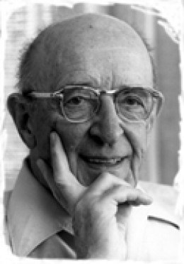
Carl Rogers
Rogers is considered a pioneer in developing
more personal techniques when dealing with clients seeking therapy.
Actualizing Tendency: Believed that all humans have the need to survive, grow, and enhance themselves. That people strive to become better people.
Client-centered Therapy: Believed that the client is able to solve his/her own problems with the help of the therapist. Believed it is the therapists responsibility to try and understand the client’s view of the world.
https://www.youtube.com/watch?v=G0yU-YJ6sjY

Slide 49
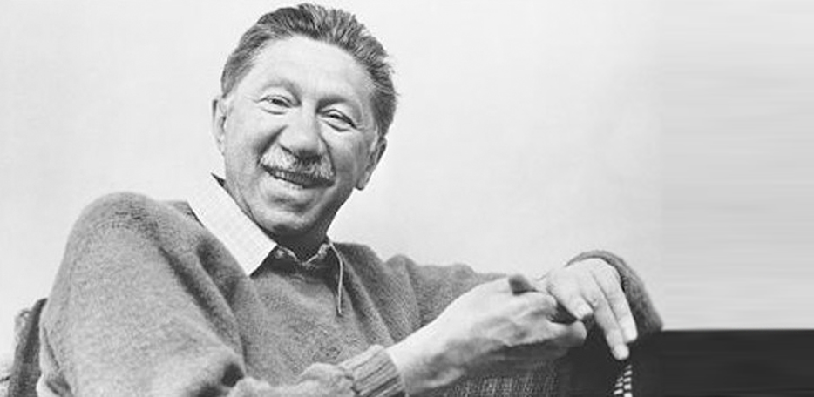
Abraham Maslow
One of Maslow’s most famous contributions to psychology was his hierarchy of human needs. He believed that people needed to satisfy certain levels of needs in a certain order if they were to become the best people they could be.
https://www.youtube.com/watch?v=qQJwE6yg6cY

Slide 50
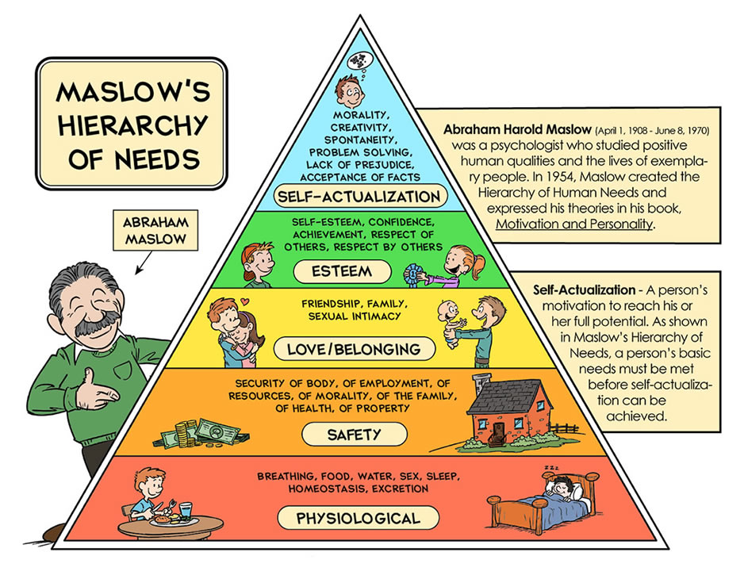

Slide 51
Characteristics of Self-actualizing
Two of the figures he believed to be self-actualized were Albert Einstein and Eleanor Roosevelt.
Criteria for Self-actualization was:
The ability to perceive reality accurately and fully.
The ability to accept one’s self and others without judgement.
The ability to be concerned with problems that do not involve themselves.
Being creative
Having a strong ethical sense.

Slide 52
Criticisms
He was criticized for being overly optimistic in regards to human nature
Critics believed that Maslow’s theories did not account for people who did terrible things nor for those who do not care for others.
Lacking scientific basis

