Slide 1
The Brain and Behavior

Slide 2
Left and Right Hemisphere is there a difference?

Slide 3
C
E C
R O
E R
B T
R E
A X
L

Slide 4
Corpus Callosum
The two hemispheres are connected by the Corpus Callosum, a thick bundle of specialized neurons that allow the two sides to communicate with one another.

Slide 5
Can people function without a part of their brain???
https://www.youtube.com/watch?v=FrULrWRlGBA – Phineas Gage
http://www.kkrv.com/kid-missing-25-brain-graduated-high-school-first-class/ - Valedictorian

Slide 6
Frontal Labotomies
What are they??
https://www.youtube.com/watch?v=_0aNILW6ILk
(viewer discretion is advised!!)
What do they cause?
-Personality changes
- A once active person becomes very quiet and still- almost to the point of being comatose.

Slide 7
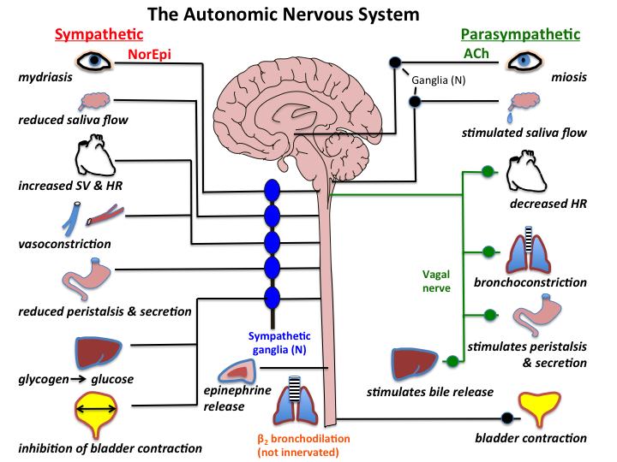
The nervous system
https://www.youtube.com/watch?v=71pCilo8k4M

Slide 8
The Nervous System
Autonomic Nervous system:
-What is it?
-Controls the life-sustaining processes (breathing, sleeping, beating of the heart) which is not under our conscious control
Sympathetic Division:
-What is it?
-Deals with responding to emergency or crisis situations by deciding to either flee or fight. Also depends on reaction time.
Parasympathetic Division:
-What is it?
-Regulates normal body functioning. Basically takes care of all the non-emergency functioning such as waste elimination, conservation of body energy, and returning bodily functions back to normal

Slide 9
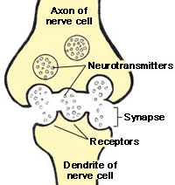
Neurotransmitters
https://www.youtube.com/watch?v=6uMcdpiV094

Slide 11
Neurotransmitters

Slide 12
Neurotransmitters

Slide 13
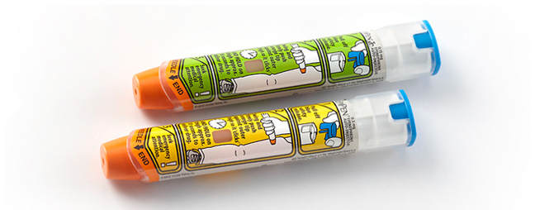
Neurotransmitters
Epinephrine,
more commonly known as adrenaline, is a hormone secreted by the medulla of the adrenal glands. Strong emotions such as fear or anger cause epinephrine to be released into the bloodstream, which causes an increase in heart rate, muscle strength, blood pressure, and sugar metabolism. This reaction, known as the “Flight or Fight Response” prepares the body for strenuous activity.

Slide 14
Neurotransmitters

Slide 16
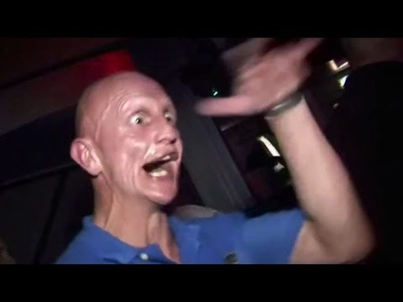
What about using artificial neurotransmitters??
Coffee, drugs, prescription drugs?
https://www.youtube.com/watch?v=4YOwEqGykDM
https://www.youtube.com/watch?v=vxI7PTVRfhQ

Slide 17
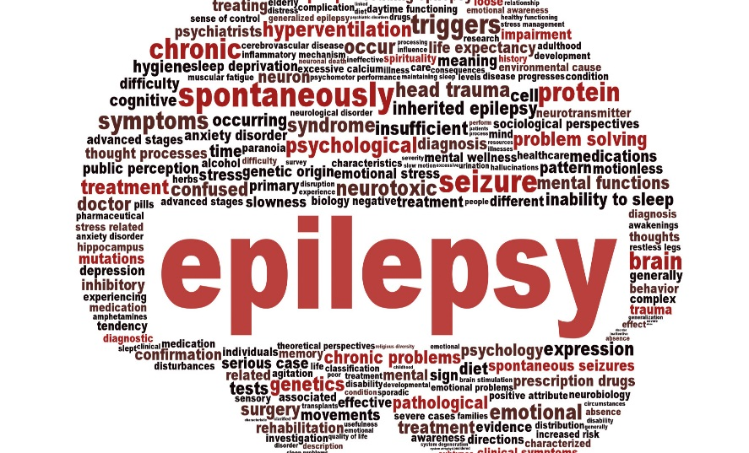
Neurological Disorders
Epilepsy→ What is it??
https://www.youtube.com/watch?v=6NcqQkKjqTI

Slide 18
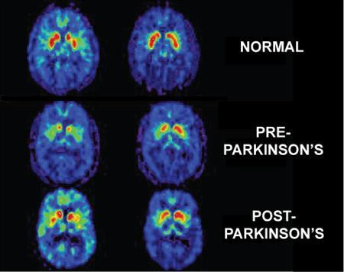
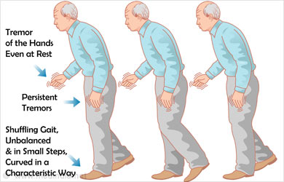
Neurological Disorders
Parkinson’s Disease→ What is it?
EXPERIMENT!!
https://www.youtube.com/watch?v=hu4eTijdIv0

Slide 19
Neurological Disorder
Alzheimer’s disease→ What is it?
https://www.youtube.com/watch?v=9Wv9jrk-gXc
Lets look at a case
https://www.youtube.com/watch?v=LL_Gq7Shc-Y

Slide 20
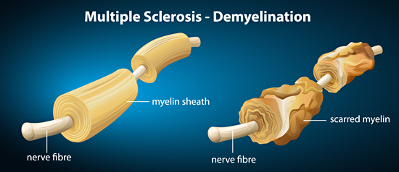
Neurological Disorder
Multiple Sclerosis→ What is it?
https://www.youtube.com/watch?v=Naecv3h868c
https://www.youtube.com/watch?v=kwAKvwTL8T0

Slide 21
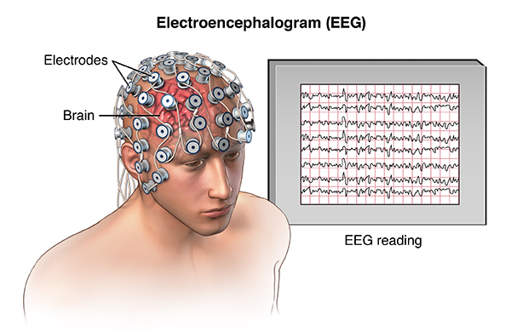
Monitoring the brain
What are some ways we can monitor the brain?
There are 3 machines that are highly important:
-Electroencephalograms (EEGs)- Records brain wave activity. Brain waves change depending upon the type of thinking. Detects malfunctions that occur in any of the neurons.
https://www.youtube.com/watch?v=1ovv6lmPHSI

Slide 22
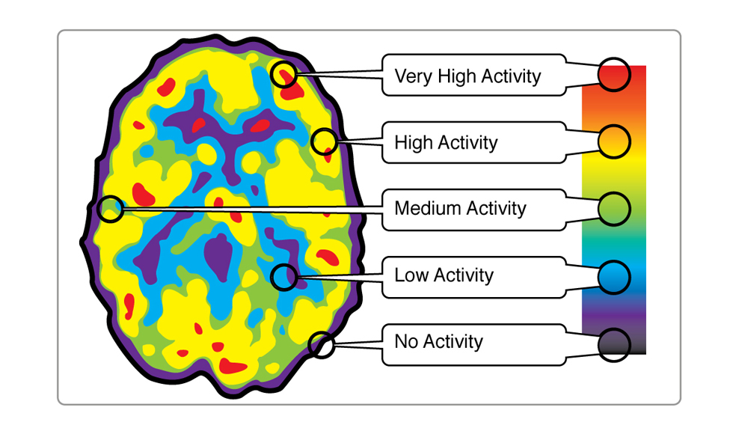
Monitoring the brain
Positron Emission Tomography (PET Scans): Is a method by which doctors can look at which areas of the brain are active at any given time. An active area of the brain requires glucose. So doctors administer a radioactive solution containing glucose (injected), active areas of the brain then give off temporary radioactivity

Slide 23
Monitoring the Brain
Magnetic Resonance Imaging (MRIs): Use magnetic pulses to show researchers the health of cells. The machine can tell if a certain area of the brain are full of water or are processing oxygen efficiently.
They are used not only to get an image but to also monitor soft tissue in the human body
https://www.youtube.com/watch?v=1CGzk-nV06g

Slide 24
The Endocrine System
This system consists of glands that produce and release hormones into the body.
https://www.youtube.com/watch?v=HXPCQBD_WGI
What are hormones?
-They are responsible for controlling body temperature, controlling feeding behavior, determining which sex organs a child develops, and effects the moods of both men and women.
https://www.youtube.com/watch?v=MNRJMN9oM4M

Slide 25
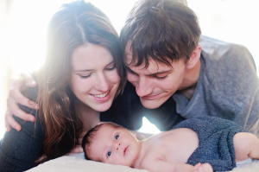
The Endocrine System
What are some other important hormones??
-Progesterone, prolactin, estradiol
https://www.youtube.com/watch?v=VkrOl5c4Qjw

Slide 26
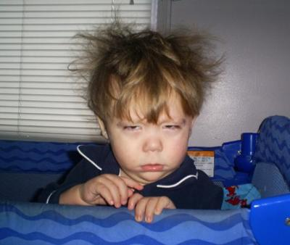
How important is Sleep?
We need sleep for our brain and neurotransmitters to replenish themselves.
Physiological Changes during Sleep:
-The brain produces electrical impulses that change depending on a person being awake or asleep. These impulses are measured by a EEG (electroencephalograms)
-The human body goes through 5 different stages during sleep.
https://www.youtube.com/watch?v=mNeLuB2KKpY

Slide 27
Physiological changes during sleep
Stage One (light sleep): In this stage the person drifts in and out of sleep and can be awakened quite easily.
Some people awakened during this stage can recall seeing some images
Can experience sudden muscle contractions accompanied by the feeling that you are falling.
Bodies can start, or make a jump, waking the person.
https://www.youtube.com/watch?v=RlahSNCBqAo

Slide 28
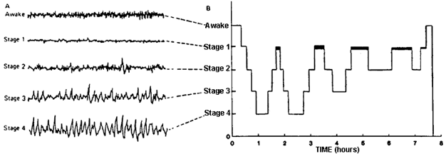
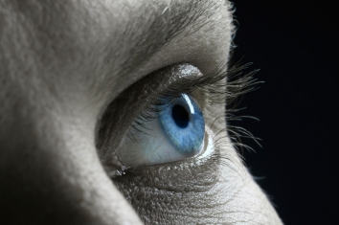
Physiological changes during sleep
Stage Two:
Spend about 50% of your sleep at this stage
Involves our eye movements stopping and our brain waves showing a pattern much slower than we are awake.
Occasionally a rapid, fast burst of brainwave activity occurs for a brief period.

Slide 29
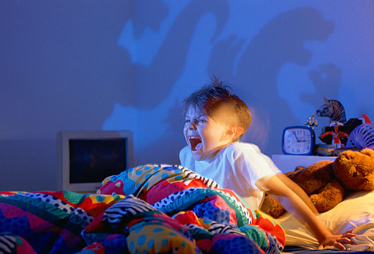
Physiological changes during sleep
Stage Three (Deep Sleep):
Brain waves become even slower and a pattern of delta waves occur with the occasional burst of smaller, faster waves.
Waking people is difficult. When they are awakened they feel disoriented and groggy.
No eye movement or muscle activity
People experience night terrors,
bed wetting, and sleep walking.

Slide 30
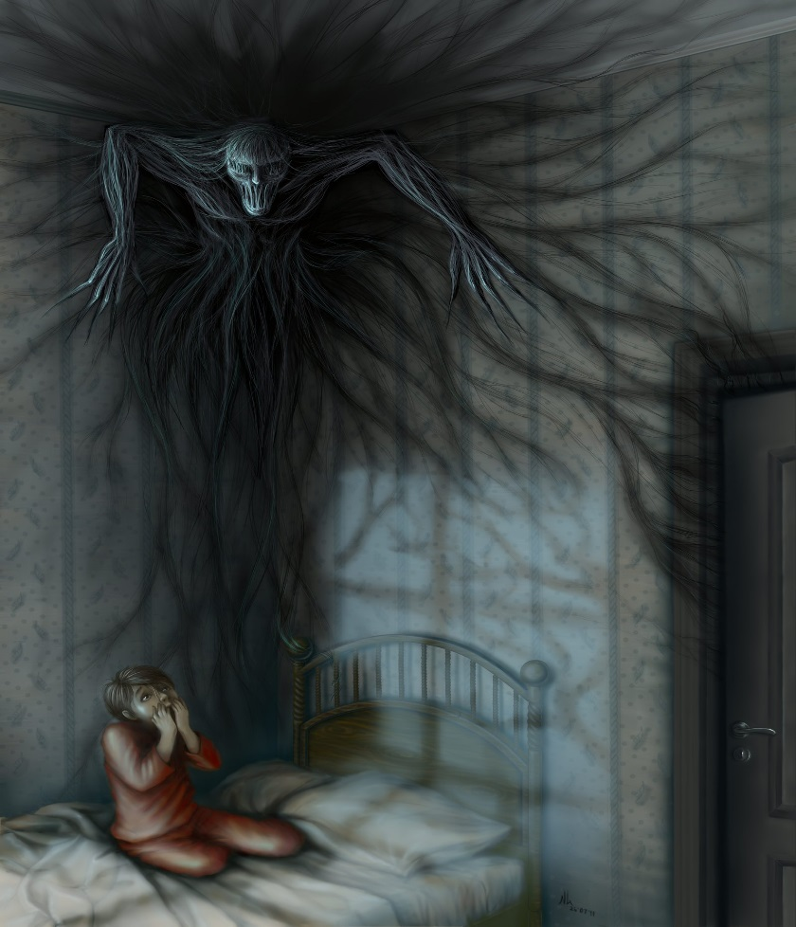
Physiological changes during sleep
What are night terrors?
https://www.youtube.com/watch?v=4ujSv2z3MEk
https://www.youtube.com/watch?v=bSVwmSzxKtU

Slide 31
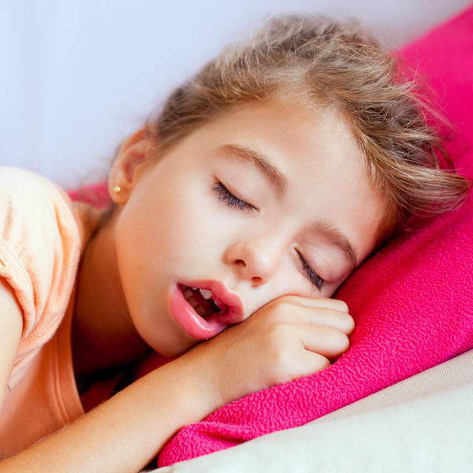
Physiological Changes during Sleep
Stage Four (Deep Sleep):
Brain produces delta waves almost exclusively
All the effects that happen during stage three also happen at this stage; the only difference is the absence of the fast bursts of waves.
https://www.youtube.com/watch?v=KmUOYWRLrKg

Slide 32
Physiological Changes during sleep
REM Sleep:
-Body functions accelerate. Breathing becomes more rapid, irregular, and shallow, and our eyes move rapidly in all directions.
Our arm and leg muscles become paralyzed, heart rate increases, and our blood pressure rises.
In this stage dreaming occurs https://www.youtube.com/watch?v=B1NPBdXYwQ8
The amount of time a person spends in REM sleep depends on the persons age. (baby:50%, young adult:20%, elderly:15%)
Develops pathways between nerves and muscles, stores new memories and new experiences in the neural networks of the brain.

Slide 33
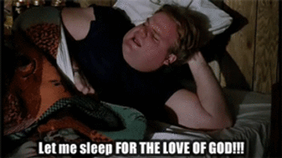
How does Sleep effect behavior?
https://www.youtube.com/watch?v=nNhDkKAvxFk
How much sleep do we actually need?
https://www.youtube.com/watch?v=SVQlcxiQlzI

Slide 34
How much sleep does a person need?
What does it depend on?
Age. Example: (babies require 16 hours a day, teenagers need 9 hours, and adults require 7-8, although some adults may require as few as 5 hours to as much as 10 hours.
Sex. Example: Some women require one or two more hours of sleep than men. This may also increase during the menstrual cycle.
Health. Example: Fighting a cold, flue, disease, or infection

Slide 35
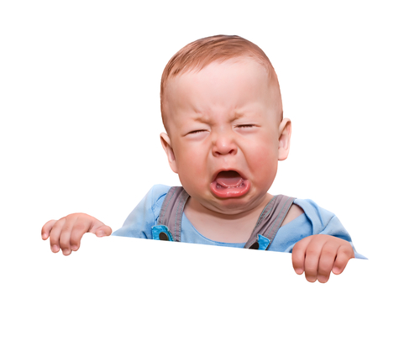
How much sleep does a person need?
How do you know whether you getting enough sleep?
-You wake up feeling refreshed
-You are not drowsy
-You don’t want to fall asleep within five minutes of lying down
-If you don’t get enough sleep your body builds up a sleep debt.

Slide 36
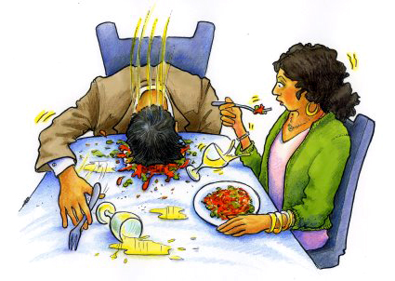
Disorders of Sleep
Narcolepsy:
Sudden, unpredictable, onset of sleep, also known as a sleep attack.
Caused by a brain malfunction that engages the brain to go into REM sleep at inappropriate times.
Occurs when the person is inactive
Attacks usually last about 3 minutes, but the person wakes feeling refreshed.
Cataplexy: occurs during times of extreme stress. Can be mistaken for fainting.
Has strong genetic component. But can be corrected with drugs that affect the neurotransmitters.
https://www.youtube.com/watch?v=Myaonferplk

Slide 37
Disorders of Sleep
Night Terrors:
Characterized by sudden awakening, screaming, and heart racing with a feeling of being terrified.
People have no memory of their night terror upon wakening unlike nightmares.
Some believe night terrors is caused by a nightmare, however this is unlikely because these terrors occur during Delta sleep, which is the part of the sleep cycle not linked to dreaming.
Why a person moves around during Delta sleep has still to be explained!

Slide 38
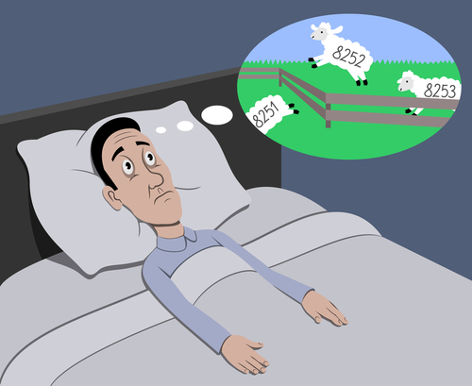
Disorders of Sleep
Insomnia:
https://www.youtube.com/watch?v=WgYpYlSRWSE
Inability to fall asleep and appears to affect at least 20% of people at some time.
It has many causes and many forms.
For instance:
Some people cannot sleep because they are worried or anxious.
Drug-dependency insomnia occurs when a person becomes dependent on sleeping pills. INTERESTING FACT: studies have found that people who take sleeping pills for as little as 3 days have troubles falling asleep once they stop medication.

Slide 39
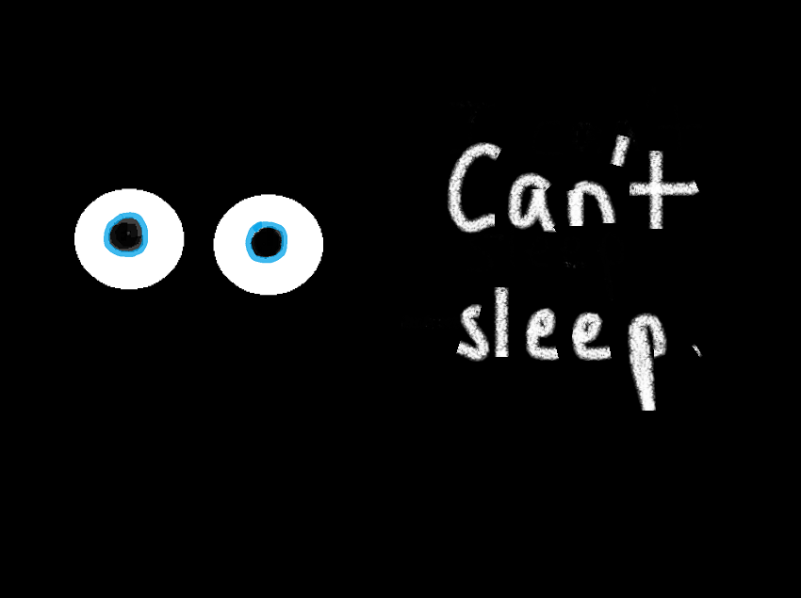
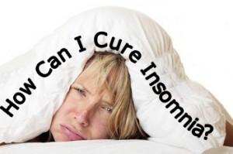
Disorders of Sleep
Insomnia:
Pseudoinsomnia: occurs when people believe that they have not slept all night but in fact they have.
This may occur because a person is completely unaware of falling asleep, or it may occur because the person actually dreams of lying awake.

Slide 40
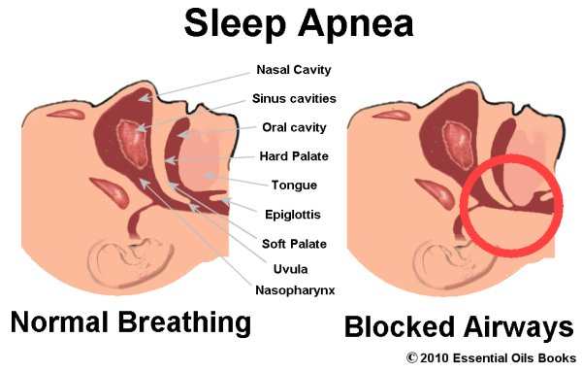
Disorders of Sleep
Insomnia:
Sleep Apnea: This type of insomnia occurs when a person stops breathing during sleep and immediately wakes up.
If the sleep apnea is severe, the person may not awake during an attack, but will awaken after a full night of sleeping feeling very tired.
Most sleep apnea is caused by a physical obstruction in the nasal cavity or throat and can be corrected by surgery.
https://www.youtube.com/watch?v=i6lxO6W2-m8

